Slide 1

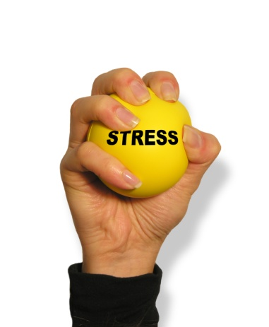
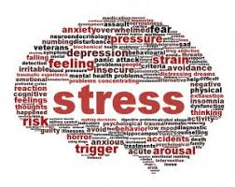
FEM 3105 – STRESS AND COPING
WEEK 2
STRESSOR & STRESS REACTION

Slide 2
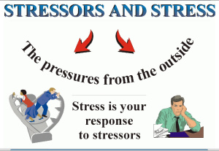
*Introduction*
Stress is simply the body's response to changes that create taxing demands.
The previously mentioned Dr. Lazarus (building on Dr. Selye's work) suggested that there is a difference between eustress, which is a term for positive stress, and distress, which refers to negative stress.

Slide 3
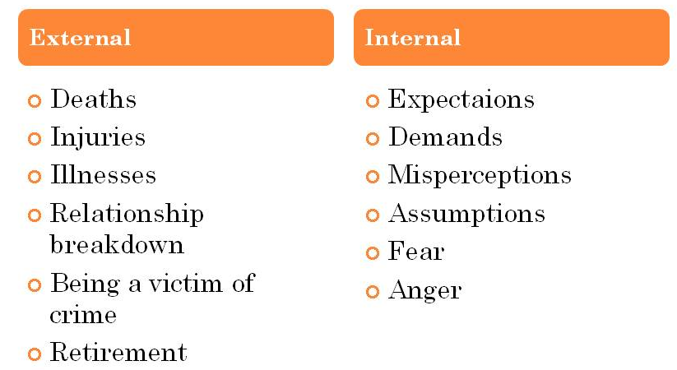
*WHAT IS STRESSOR?*
Stressor is the ‘cause’ of the stress reaction.
Stressors maybe events, thoughts or demands.
Stressors are situations that are experienced as a perceived threat to one's well-being or position in life, especially if the challenge of dealing with it exceeds a person's perceived available resources.
Pauline Boss (1988) defines stressors as events or life changes that bring about changes in family systems.
There are external and internal stressor:

Slide 4
Any factor that causes stress is called a stressor…
There are two kinds of stressors: PROCESSIVE STRESSORS and SYSTEMIC STRESSORS.
1. PROCESSIVE STRESSORS are elements in the environment perceived by the organism as potential dangers.
  Do not cause damage directly, but are processed in the cerebral cortex (brain).
  The processed information is then send via the limbic system (brain that relate to emotion) in the hypothalamus, where they activate the supreme centers of the autonomic system.
  This results in the fight or plight (acute stress response)
2. SYSTEMIC STRESSORS cause a disturbance in the organism's homeostasis and the tissue necrosis, hypotension or hypoxia.
  Often both types of stressors occur simultaneously.
  They are usually accompanied by pain and/or intensive emotions.

Slide 5

Stressors…
Situations and pressures that cause stress are known as stressors.
We usually think of stressors as being negative events such as an exhausting work schedule or a rocky relationship, but stressors can be also positive events such as getting married, buying a house, going to college, or receiving a promotion.
What causes such pressure depends, at least in part, on each individual’s perception of their ability to handle the events.
Stressors are uncontrollable or unpredictable events that can alter our normal reaction to everyday events.
Some examples are excessive workload demands, conflicting expectations, and insufficient resources both internal and external.
The stress response or reaction is a normal response to the demands and changes of life-both positive and negative.
The response is individual, physiological and necessary for survival.

Slide 6
Stress can become problematic when we are habitually confronted with chronic stress the effects are experienced in four key areas.
  Physical signs or symptoms – headaches, changes in appetite, and changes in sleep patterns.
  Mental signs or symptoms – poor concentration , confusion, poor judgment
  Emotional signs or symptoms Feeling out of control, increased anger and nervousness
  Behavioral signs or symptoms- aggression, compulsive behavior, and excessive alcohol use.
Stressors are not always limited to situations where some external situation is creating a problem. Internal events such as feelings and thoughts and habitual behaviors can also cause negative stress.
Common internally caused sources of distress include:
  Fears: (e.g., fears of flying, heights, public speaking, chatting with strangers at a party).
  Repetitive Thought Patterns.
  Worrying about future events (e.g., waiting for medical test results or job restructuring).
  Unrealistic, perfectionist expectations.
Habitual behavior patterns that can lead to distress include:
  Overscheduling.
  Failing to be assertive.
  Procrastination and/or failing to plan ahead.

Slide 7
*SOURCES OF STRESS - AGENT*
Emotional changes
A fight or a conflict with your best friend
Physical changes
A cold, allergies
Biological changes
Puberty, menopause, pre-menstrual syndrome, pregnancy
The environment
Very hot or cold weather, pollution, change in altitude

Slide 8
*PREDISPOSING FACTORS
FOR STRESS*
Genetic factors
Inability to adapt
Inadequate relaxation response
Response activity variations
Age
Personality
Isolation
Environment

Slide 9

*CLASSIFICATION OF STRESS*
Positive Stress (Eustress)
Negative Stress (Distress)
Acute Stress
Chronic Stress

Slide 10
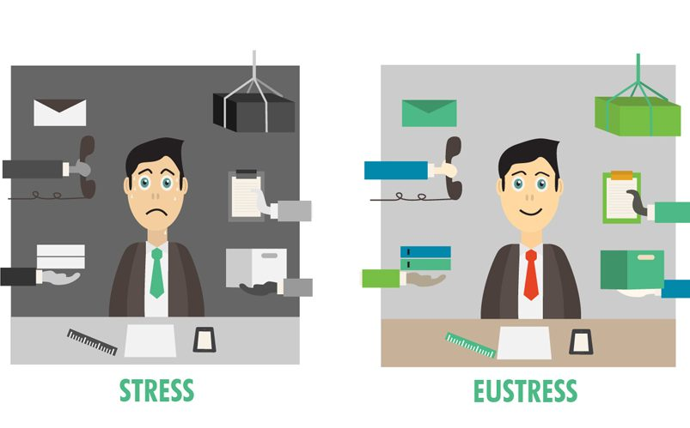
Eustress
Eustress means beneficial stress either psychological, physical or biochemical (hormesis).
The term was coined by endocrinologist Hans Selye, consisting of the Greek prefix eu meaning "good", and stress, literally meaning "good stress".
Eustress, or positive stress, has the following characteristics:
  Motivates, focuses energy.
  Is short-term.
  Is perceived as within our coping abilities.
  Feels exciting.
  Improves performance.

Slide 11
Distress
Distress implies an external and usually temporary cause of great physical or mental strain and stress. The hurricane put everyone in great distress suffering implies conscious endurance of pain or distress.
Distress is an unpleasant emotion, feeling, thought, condition, or behaviour.
Distress can affect the way you think, feel, or act, and can make it hard to cope
Distress, or negative stress, has the following characteristics:
  Causes anxiety or concern.
  Can be short- or long-term.
  Is perceived as outside of our coping abilities.
  Feels unpleasant.
  Decreases performance.
  Can lead to mental and physical problems.

Slide 12
Examples of Eustress & Distress
It is somewhat hard to categorize stressors into objective lists of those that cause eustress and those that cause distress, because different people will have different reactions to particular situations.
However, by generalizing, we can compile a list of stressors that are typically experienced as negative or positive to most people, most of the time.
Examples of negative personal stressors include:
  The death of a spouse.
  Filing for divorce.
  Losing contact with loved ones.
  The death of a family member.
  Hospitalization (oneself or a family member).
  Injury or illness (oneself or a family member).
  Being abused or neglected.
  Separation from a spouse or committed relationship partner.
  Conflict in interpersonal relationships.
  Bankruptcy/Money Problems.
  Unemployment.
  Sleep problems.
  Children's problems at school.
  Legal problems.
Examples of positive personal stressors include:
Receiving a promotion or raise at work.
Starting a new job.
Marriage.
Buying a home.
Having a child.
Moving.
Taking a vacation.
Holiday seasons.
Retiring.
Taking educational classes or learning a new hobby.

Slide 13
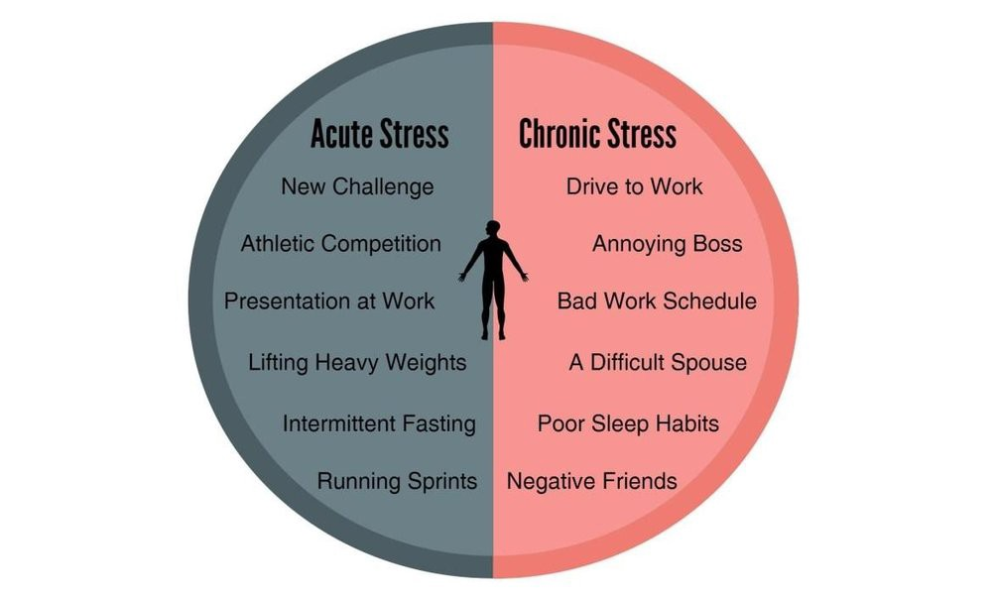
Acute and Chronic stress
Acute stress
  is the reaction to an immediate threat, commonly known as the fight or flight response.
  The threat can be any situation that is experienced, even subconsciously or falsely, as a danger . Short term. Ex: Assignment!
Chronic Stress
  Frequently, however, modern life poses on-going stressful situations that are not short-lived and the urge to act (to fight or to flee) must be suppressed. Stress, then, becomes chronic.
  Long term. Ex: relationship problem, financial worries

Slide 14
*STRESS REACTION*
Physiology
Psychology
Behavioral
Benefit of Response

Slide 15
Physical Responses to Stress
Butterflies in the stomach
Change in appetite
Chest pains
Diarrhea
Dilated pupils
Dry mouth
Frequently passing urine
Headaches
Indigestion
Muscle tension
Over-alertness
Pins and needles
Rapid, uneven heartbeat
Sleep problems
Sweating
Unexplained pains

Slide 16
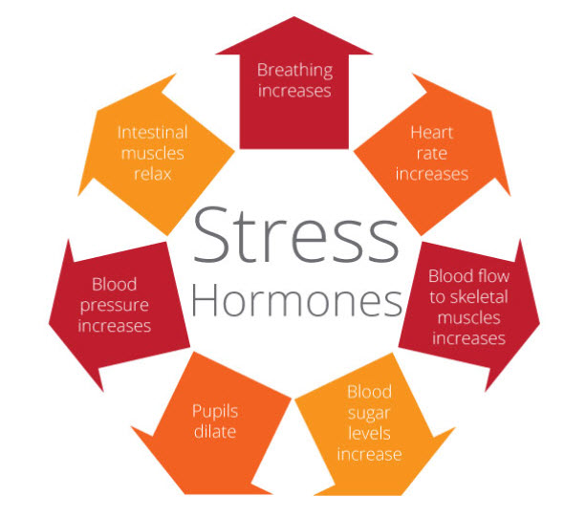
*STRESS HORMONES*
The body reacts to stress first by activating the Autonomic Nervous System.
Stress hormones (glucocorticoids) are secreted - Cortisol from adrenal .
They help us to cope by increasing heart rate and blood pressure, replenishing energy
Stress also secreted neurotransmitter called catecholamine, particularly those known as known as dopamine, norepinephrine, and epinephrine (also called adrenaline).
Stress can have a major impact on the physical functioning of the human body.
increases the heart-rate, respiration, blood-pressure and puts more physical stress on bodily organs.
Long-term stress can be a contributing factor in heart disease, high blood pressure, stroke and other illnesses.

Slide 17
Emotional Responses to Stress
Becoming fussy or gloomy
Being unable to make decisions
Constantly worried or frightened
Fear of imminent fainting or collapse
Feeling under pressure
Feeling mentally drained
Feeling tense and unable to relax
Feelings of conflict
Impulse to run and hide
Increased tearfulness
Restlessness, inability to concentrate

Slide 18
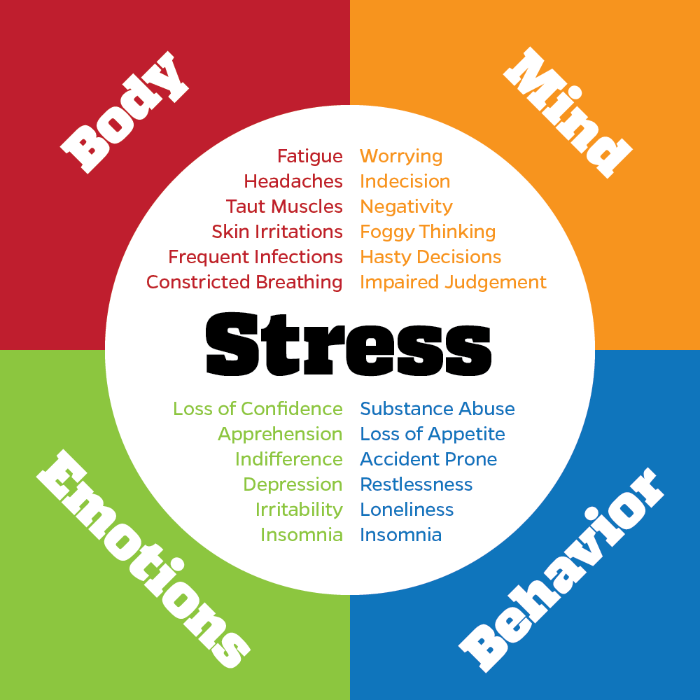
*Behavioral Signs and Symptoms of Stress*
Increased smoking
Aggressive behaviors (such as driving - road rage, etc.)
Increased alcohol or drug use
Carelessness
Under-eating
Over-eating
Nervous laughter
Compulsive behavior
Impatience
Withdrawal
Listlessness
Hostility
Accident-proneness

Slide 19
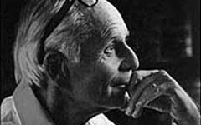
*General Adaptation Syndrome*
(GAS)
Definition
General adaptation syndrome describes the body's short-term and long-term reaction to stress.
Hans Selye was a young medical doctor who noticed that a lot of people were experiencing similar types of symptoms but did not have any physical cause for the problems.
The problems were caused by stress.
He later determined that the body has a natural, adaptive response to stress that is composed of three stages: alarm, resistance, exhaustion.
Hans Selye(1907-1982)
Father of Stress

Slide 20
GAS : Causes and symptoms
Stress is the cause of general adaptation syndrome and it can manifest as fatigue, irritability, difficulty concentrating, and difficulty sleeping.
Persons may also experience other symptoms that are signs of stress.
Persons experiencing unusual symptoms, such as hair loss, without another medical explanation might consider stress as the cause.
GAS can occur with any type of stress. Stressful events can include:
  a job loss
  medical problems
  financial troubles
  family breakdown
  trauma
But while stress is unpleasant, the upside is that GAS improves how your body responds to stressors, particularly in the alarm stage.
Notes:
FATIGUE SEBAGAI KELETIHAN YANG TERAMAT SANGAT, RASA MARAH, TIDAK DAPAT MEMFOKUS DENGAN BAIK DAN TERUTAMANYA MASALAH TIDUR YANG TIDAK LENA.
Simptom ini meruapakan simptom yang jelas dan tidak perlu dihuraikan sevara medikal. Ramai juga yang mengalami simptom yang agak luarbiasa seperti rambut gugur atau yang tidak dapat dihuraikan secara saintifik.

Slide 21
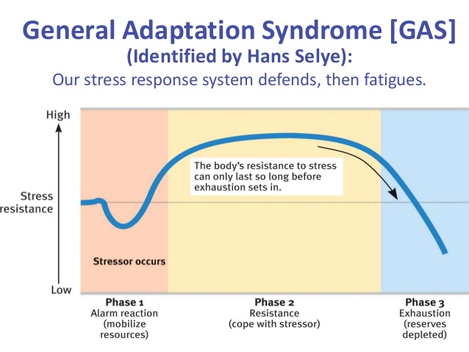
OUR BODY’S REACTION TO STRESS (GENERAL ADAPTATION SYNDROME (GAS)
PHASES OF GAS:
1: Alarm reaction:
  Body’s first response
2: Resistance or adaptation:
  Body adapts to stressor
3: Exhaustion:
  Body breaks down
  Changes in immune system

Slide 22
STAGE 1: ALARM REACTION
The first stage of the general adaptation stage (GAS), the alarm reaction, is the immediate reaction to a stressor.
In the initial phase of stress, humans exhibit a "fight or flight" response, which causes one to be ready for physical activity.
However, this initial response can also decrease the effectiveness of the immune system, making persons more susceptible to illness during this phase.
The body reacts to acute stress by increasing the production of hormones by the medullar part of the adrenal gland in order to mobilise the physical energy needed to combat the stress.
When the stress is extremely acute the body's alarm reaction takes the form of inflammation.
If the reaction is strong enough to overcome and remove the stress, the organism regains its balance and returns to its normal homeostatic condition.
Notes:
During this stage, heart rate, blood pressure and respiration rise in order to supply muscles and brain with more oxygen. More blood is sent to the skeletal muscles and the brain, while blood flow decreases to the stomach, kidneys, skin and liver. Sexual and immune functions are suppressed. Hormones acting as natural opiates are released, in order to relieve potentially existing pain. Natural fats and sugars are actively produced to supply the organism with extra energy. Senses become sharper. The organism activates those systems crucial for an immediate physical response and decreases the energy supply to those organs, which are not so important in a state of emergency.
In the first stage of GAS called alarm reaction, the body releases adrenaline and a variety of other psychological mechanisms to combat the stress and to stay in control. This is called fight or flight response. The muscles tense, the heart beats faster, the breathing and perspiration increases, the eyes dilate, the stomach may clench. Believe it or not, this is done by nature to protect you in case something bad happens. Once the cause of the stress is removed, the body will go back to normal.

Slide 23
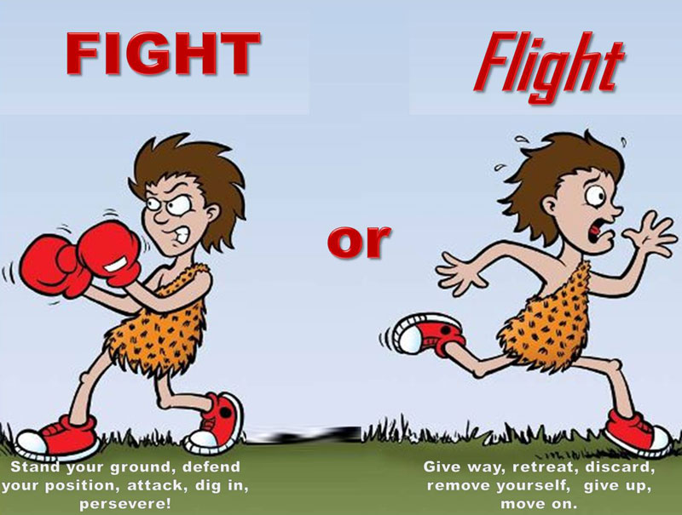
The fight or flight response
CONT ….(STAGE 1: ALARM REACTION)
Also called the "acute stress response", was first described by Walter Cannon in the 1920s as a theory that animals react to threats with a general discharge of the sympathetic nervous system. The response was later recognized as the first stage of a general adaptation syndrome that regulates stress responses among vertebrates and other organisms.
Notes:
Waltor Cannon yang memulakan pengunaan fight or flight.
Fight or flight wuijud dalam entuk respons kepaxa stress yang acute i.e. belum chronic. Konsep chronic diperkembangkan lagi oleh rakannya Hans Selye.
He discovered a role for emotions in adrenalin release. He coined the idea of the "fight or flight" control systems of the body.
Canon was the first to use the word "stress" in a biological rather than engineering context. He helped explain how the body stays in functional balance through the opposite actions of different parts of the nervous system.
This research led him to develop the concept of "homeostasis," which is the idea that normal bodily function requires a steady balance in the function of various organ systems. The lack of such balance, or homeostasis, is disease.

Slide 24
CONT ….(STAGE 1: ALARM REACTION)
During the alarm phase, a stressor disturbs homeostasis.
The brain subconsciously perceives the stressor and prepares the body either to fight or to run away, a response sometimes called the fight or flight response
Body releases adrenaline and a variety of other psychological mechanisms to combat the stress and to stay in control.
Rising hormone levels results in increased blood volume, blood glucose levels, epinephrine and nor-epinephrine amount, heart rate, blood flow to muscles, oxygen intake and mental alertness.
In addition , the pupils of the eye dilate to produce greater visual field
May last from 1 minute to many hours
Once the cause of the stress is removed, the body will go back to normal.
If not resolved………. person enters into resistance or adaptation stage!

Slide 25
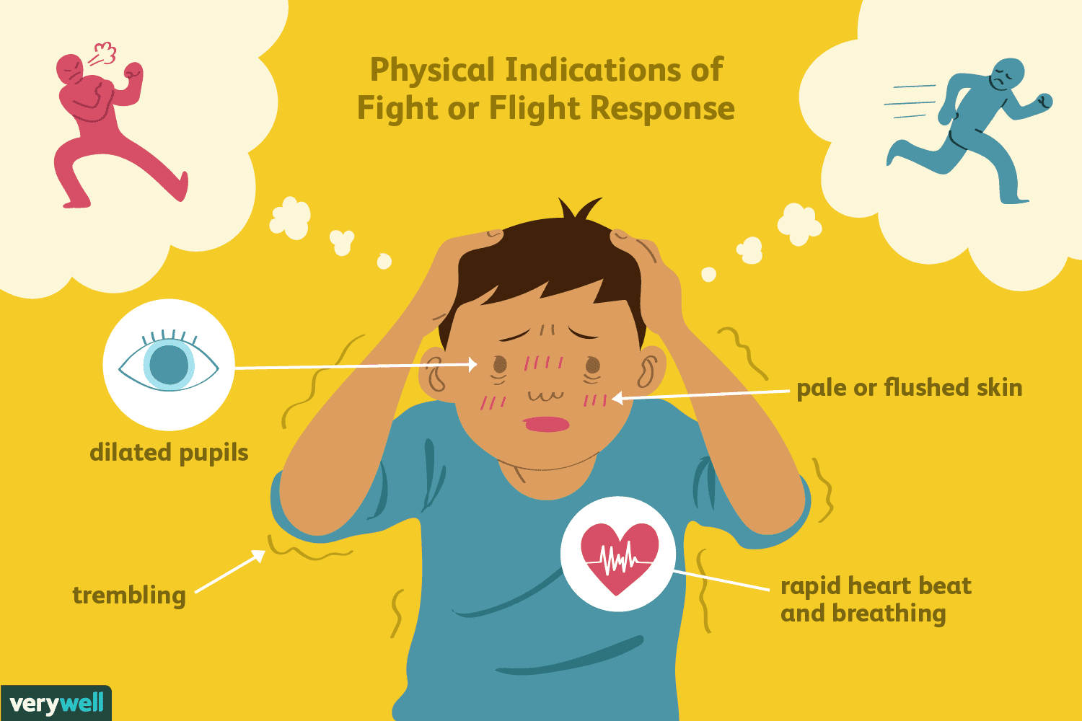
ALARM REACTION!!!!
CONT ….(STAGE 1: ALARM REACTION)
Muscles tense
Heart beats faster
The breathing and perspiration increases
The eyes dilate
The stomach may clench

Slide 26
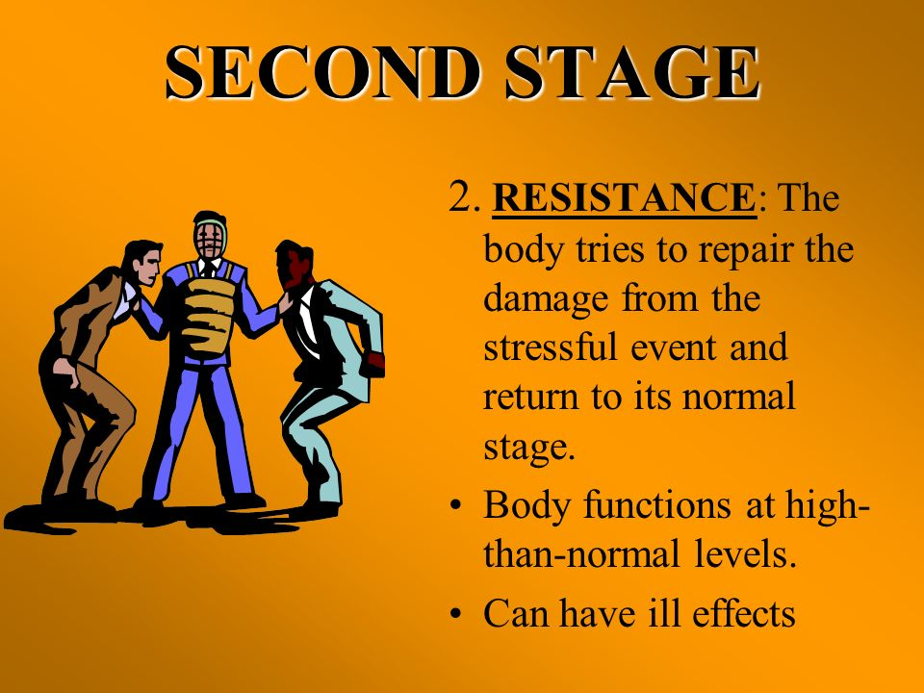
STAGE 2: STAGE OF RESISTANCE
Stage 2 might also be named the stage of adaptation, instead of the stage of resistance.
During this phase, if the stress continues, the body adapts to the stressors it is exposed to.
Changes at many levels take place in order to reduce the effect of the stressor.
For example, if the stressor is starvation (possibly due to anorexia), the person might experienced a reduced desire for physical activity to conserve energy, and the absorption of nutrients from food might be maximized.
Notes:
If the cause for the stress is not removed, GAS goes to its second stage called resistance or adaptation. This is the body’s response to long term protection. It secretes further hormones that increase blood sugar levels to sustain energy and raise blood pressure. The adrenal cortex (outer covering) produces hormones called corticosteroids for this resistance reaction. Overuse by the body's defense mechanism in this phase eventually leads to disease. If this adaptation phase continues for a prolonged period of time without periods of relaxation and rest to counterbalance the stress response, sufferers become prone to fatigue, concentration lapses, irritability and lethargy as the effort to sustain arousal slides into negative stress.

Slide 27
CONT…(STAGE 2: STAGE OF RESISTANCE)
In this phase, the body has reacted to the stressor and adjusted in a way that begins to allow the body to return to homeostasis
This is the body’s response to long term protection.
It secretes further hormones that increase blood sugar levels to sustain energy and raise blood pressure.
The adrenal cortex (outer covering) produces hormones called corticosteroids for this resistance reaction.
Overuse by the body’s defense mechanism in this phase eventually leads to disease
If this adaptation phase continues for a prolonged period of time without periods of relaxation and rest to counterbalance the stress response, sufferers become prone to fatigue, concentration lapses, irritability and lethargy as the effort to sustain arousal slides into negative stress.
If stressor remains for prolonged period and person unable to adapt…. Person enters into Exhaustion Stage

Slide 28
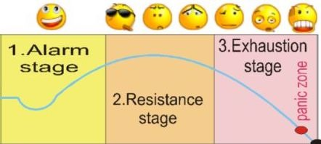
Indications of : Resistance or Adaptation stage
CONT…(STAGE 2: STAGE OF RESISTANCE)
Fatigue
Concentration lapses
Irritability and lethargy

Slide 29
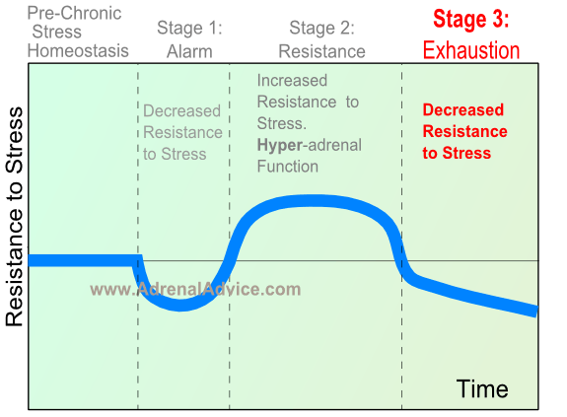
STAGE 3: STAGE OF EXHAUSTION
At this stage, the stress has continued for some time.
The body's resistance to the stress may gradually be reduced, or may collapse quickly.
Generally, this means the immune system, and the body's ability to resist disease, may be almost totally eliminated.
Patients who experience long-term stress may succumb to heart attacks or severe infection due to their reduced immunity.
For example, a person with a stressful job may experience long-term stress that might lead to high blood pressure and an eventual heart attack.

Slide 30
EXHAUSTION STAGE (ES)
STAGE 3: STAGE OF EXHAUSTION
This is the G.A.S. phase where depletion is so high that the patient loses the ability to adapt to the stress.
It is the phase when medical intervention is requested for a number of symptoms, which are sometimes difficult to define.
The organism has exhausted its energy reserves trying to contain the stress and starts to self-destruct.
At this stage we see a significant decrease in the levels of sodium relative to potassium.
The typical symptom of the exhaustion phase is chronic fatigue which is probably the most widespread symptom.
In this stage, the body has run out of its reserve of body energy and immunity.
Mental, physical and emotional resources suffer heavily.
The body experiences "adrenal exhaustion".
The blood sugar levels decrease as the adrenals become depleted, leading to decreased stress tolerance, progressive mental and physical exhaustion, illness and collapse.
If stress continues, death may result.
Notes:
The third stage of GAS is called exhaustion. In this stage, the body has run out of its reserve of body energy and immunity. Mental, physical and emotional resources suffer heavily.
The body experiences "adrenal exhaustion". The blood sugar levels decrease as the adrenals become depleted, leading to decreased stress tolerance, progressive mental and physical exhaustion, illness and collapse.

Slide 31
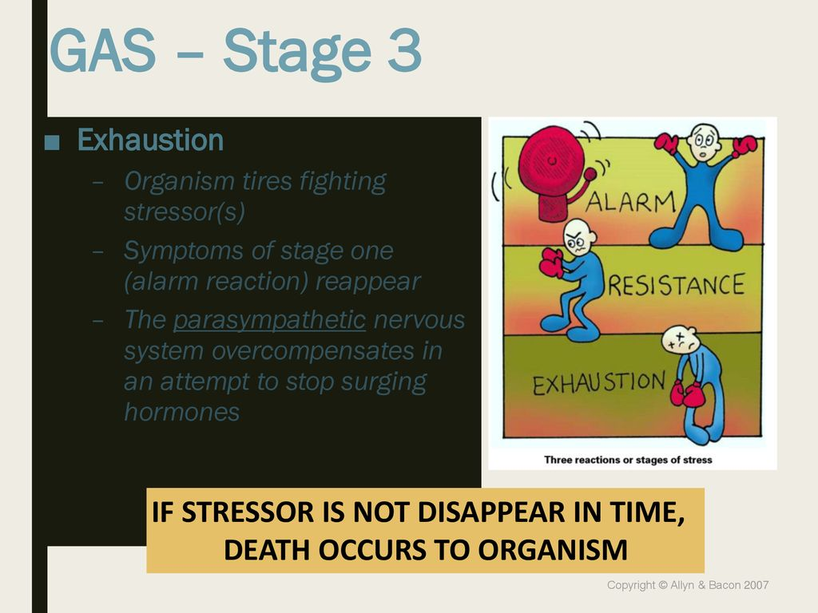
*INDICATIONS OF EXHAUSTION*
STAGE 3: STAGE OF EXHAUSTION
Decreased stress tolerance
Progressive mental and physical exhaustion
Illness and collapse

Slide 32
WHAT HAPPEN IF GAS CONTINUES?
STAGE 3: STAGE OF EXHAUSTION
Purpose of the stress is to protect life
If the response to stress is positive such as physical action, then the stress products i.e. the increased chemical in the body are used up – OK
If the stress is not resolved and the stress products are not used up for its intended purpose, then our body continues to be stimulated.
Then over time, our body adapts by developing ‘diseases of adaptation’ or stress related diseases.
Severe Exhaustion Stage
Chronic sadness or depression
Chronic mental and physical fatigue
Chronic stress related illnesses (headache, stomach ache, bowel problems, etc.)
Isolation, withdrawal, self-destructive thoughts

Slide 33
*CONCLUSION*
Physical damage comes more from prolonged stress than from sudden of fear.
Second stage of GAS is important for adaptation.
Chronic state of stress – physical or psychological has damaging effect.
Psychosomatic disorder resulting from prolonged stress.

